Slide 1
Multi-strain models
Cristina Lanzas
CBS810 Infectious disease modeling
October 14th 2015

Slide 2
Learning objectives
Explain why considering the multi-strain nature of pathogens is important
Explain the competitive exclusion principle for parasites
List mechanisms that favor co-existence of multiple strains
Explain how partial cross-immunity is addressed in a SIR model

Slide 3
Many diseases are caused by pathogens with multiple strains
Large number of cocirculating strains:
Pneumococcus (> 90 strains)
Meningococcus (>12 strains)
Rhinovirus (>150 strains)
Small number of strains co-circulate and are displayed fast
Influenza
Small number of strains that co-exist for long period of time
Dengue

Slide 4
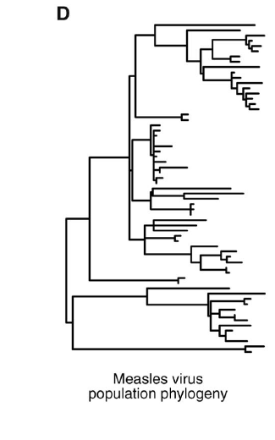
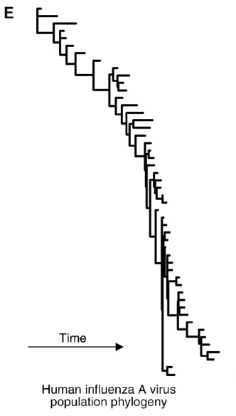
Interactions among strains are important to understand pathogen evolution
Grenfell et al. Science 303 (2004): 327-332

Slide 5
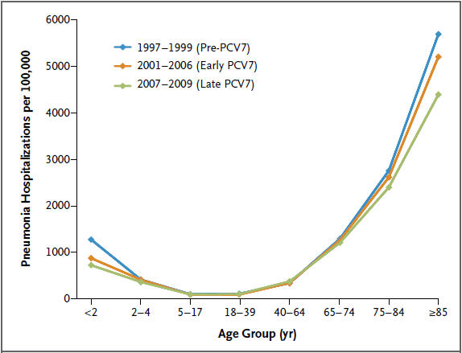
Does serotype replacement erode the benefits of pneumococcal vaccination?
http://blogs.nejm.org/now/index.php/does-serotype-replacement-erode-the-benefits-of-pneumococcal-vaccination/2013/07/10/

Slide 6
1-strain endemic model
μ
μ
γ
β
γ
β
S
S
S
I
I
I1
R
R
R
m
μ
μ
μ
μ
μ
**s, i, and r are proportions

Slide 7
2-strain endemic model with complete cross-immunity
μ
μ
γ
β
γ1
β1
S
S
S
I
I
I1
R
R
R
β2
μ
m
μ
μ
μ
μ
I2
γ2
μ
m
Either strain confers lifelong immunity to both strains
No co-infection

Slide 8
2-strain endemic model with complete cross-immunity
μ
μ
γ
β
γ1
β1
S
S
S
I
I
I1
R
R
R
β2
μ
μ
μ
μ
μ
I2
γ2
μ
Either strain confers lifelong immunity to both
**s, I, and r denotes proportions

Slide 9
Complete cross-immunity leads to competitive exclusion
When competing strains provide complete protection for each other, the strain with the largest R₀ forces the other strain to extinction.
Evolutionary implications?

Slide 10
Evolutionary implications of complete cross-immunity
The strain with the largest basic reproduction strain will force the extinction of the other strains (runaway evolution)
Evolution favors mutants with higher basic reproduction number, with high transmission rates, long-lasting infections with low probability of mortality
Only a small subset of multi-strain pathogens (transmission-virulence trade off)

Slide 11
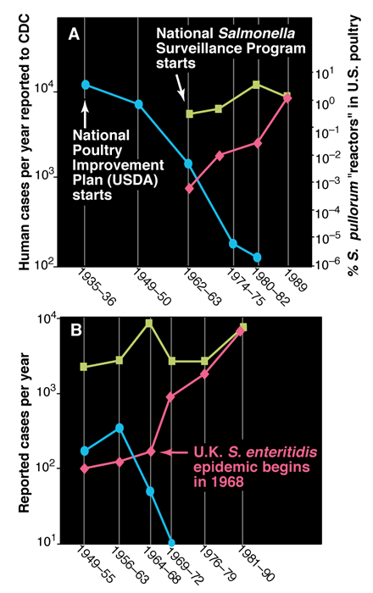
Salmonella serotypes trends
Poultry infected with S. pullorum
Human cases of S. typhimurium
Human cases of S. enteritidis
1980’s:
R0 for S. pullorum: 2.8
R0 for S. enteritidis: 1.05
Baumler et al. Science 287 (2000):50-52

Slide 12
Mechanisms that favor coexistence ?

Slide 13
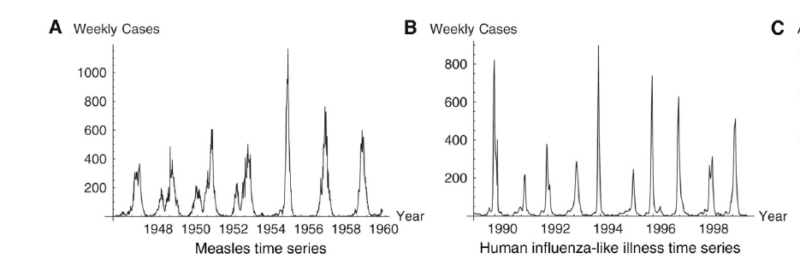
Phylodynamics
Antigenic escape mutations
Continual immune selection
Strain-transcending immunity
Spatial-temporal epidemic dynamics
Grenfell et al. Science 303 (2004): 327-332

Slide 14
2-strain model with partial cross-immunity
Recovery from one infection provides some limited protection to related strains.
Nature of cross-immunity: reduced susceptibility, reduced transmissibility, homogeneous or heterogeneous response.
Nis
Nrs
Nri
Nss
Nrr
Nsi
Nsr
Nir

Slide 15
2-strain model with partial cross-immunity
α_{i} is the proportional reduction in the susceptibility to strain i
a_{i} is the proportional reduction in the transmission of strain i

Slide 16
2-strain model with partial cross-immunity
Three types of equilibrium: (1) Disease free, (2) Only one strain is present, (3) Coexistence of both strains
The second strain can invade the equilibrium of the first strain if:
Invades if it has a greater reproduction number or the effects of cross-immunity are weak.

Slide 17
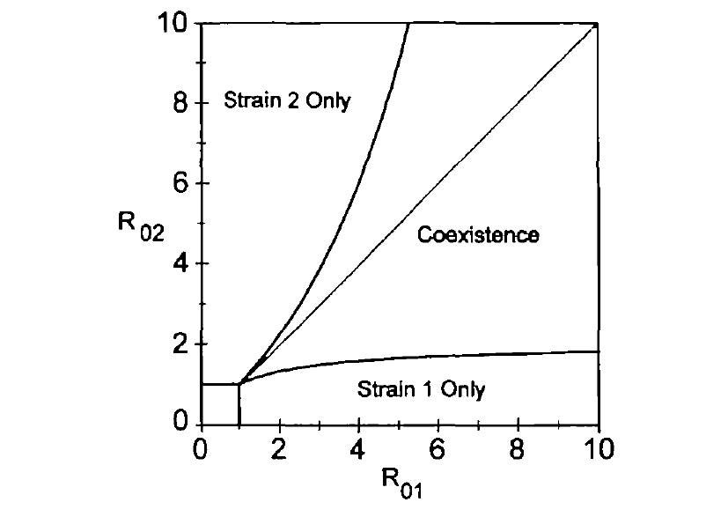
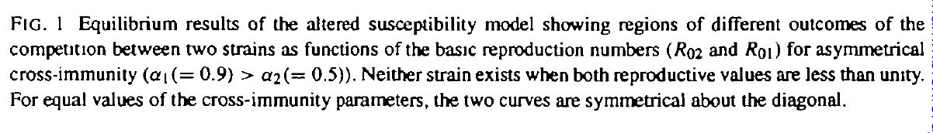
2-strain model with partial cross-immunity
White et al. Mathematical Medicine and Biology 15, 211-233 (1998).

Slide 18
Partial cross-immunity: model complexity
Nis
Nrs
Nri
Nss
Nrr
Nsi
Nsr
Nir
For n interaction strains, an SIR model requires 3^{n} differential equations or (n+2)2 ^{n-1} if co-infection is not assumed (as in the model above)

Slide 19
Summary
When competing strains provide complete protection for each other, the strain with the largest R₀ will force the other to extinction.
Numerous mechanisms favor the co-existence of strains in a host population.
Coexistence of competing strains is possible when their respective R₀ are close and the level of cross-immunity is weak.

